Slide 1
Anomaly Detection in Heart Activity
Amro Ghoneim
Ismail El Sharkawy
Zeyad Ali

Slide 2
Our Project
The aim of our project is detect anomalies in heartbeats constructed from an electrocardiogram (ECG) monitor, which is the recording of the electrical pulse/activity of one’s heart within the MCU. The recording of the heart beat will be displayed and the system will detect if there is an anomaly in the heart beat.

Slide 3
Design
The heart pulses will be detected using the AD8232 module.
The readings detected from the AD8232 will be sent to the STM32 microcontroller on one of its ADC input pins.
The readings will then be given to the machine learning model deployed on the MCU for real time inference
The readings/output will then be transmitted via UART and/or displayed on MCU(LEDs) which will be received by a python application.
The application will will take the readings and display them.

Slide 4
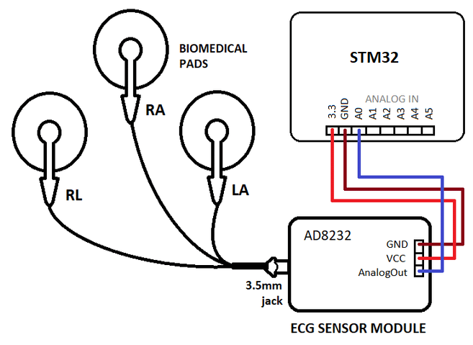

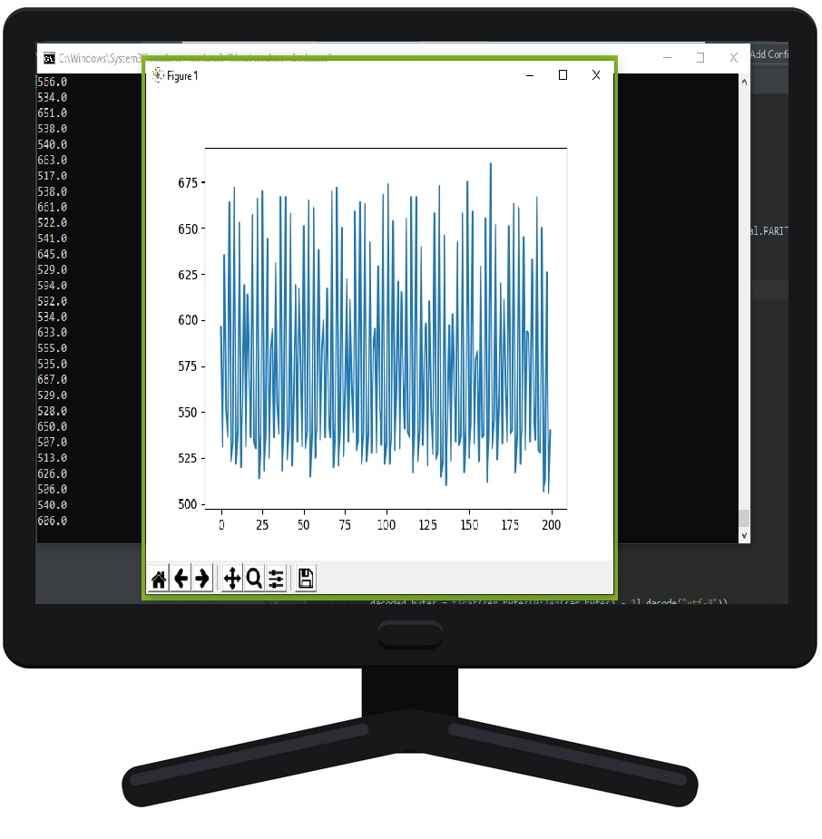
Design

Slide 5
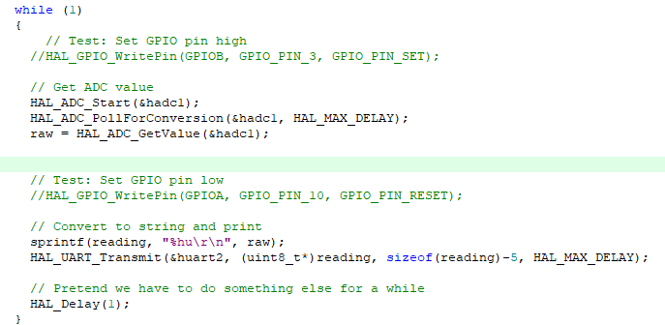
Implementation: Keil
The embedded code on the STM32 received the ADC input from the AD8232 and transmitted it through the UART. (Sampling rate unchanged)

Slide 6
Implementation: Python Application
Using python’s library Pyserial, the port of interest “COM3” was specified alongside the corresponding baudrate.
UART output is read line by line and formatted using the decode(”utf-8”) function after being parsed to output desired format.
Data is then gathered and stored in a csv file for later review.
For better visualization of errors and changes, data is then graphed in real time as shown in slide 8.

Slide 7
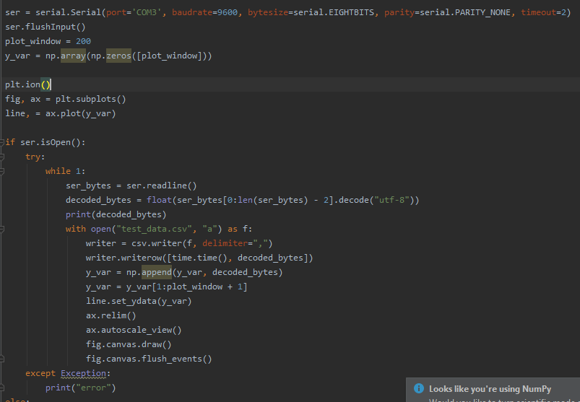

Slide 8
Results

Slide 9
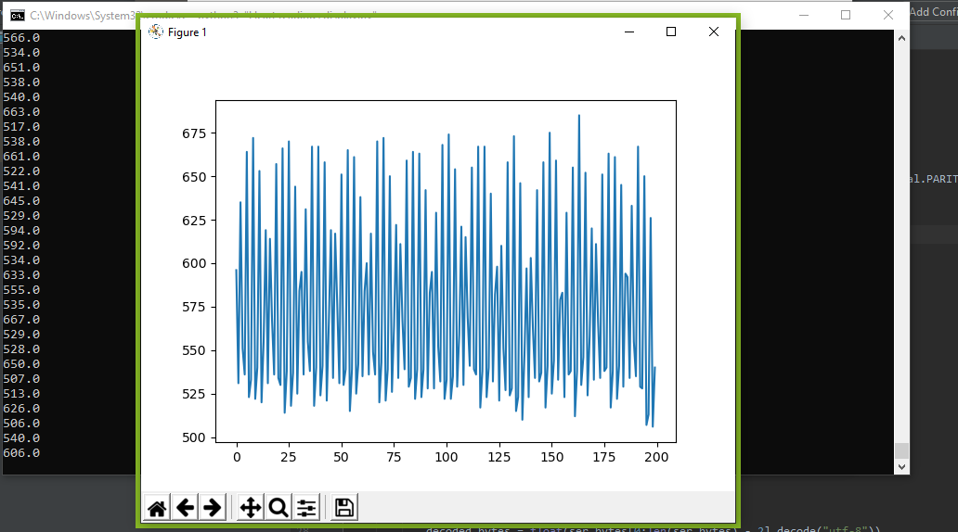
INSERT PICTURE OF GRAPH HERE

Slide 10
About the Data set
Number of Samples: 109446
Number of Categories: 5
Sampling Frequency: 125Hz
Data Source: Physionet's MIT-BIH Arrhythmia Dataset
Preprocessing steps described in this paper to create the data set
Classes: ['N': 0, 'S': 1, 'V': 2, 'F': 3, 'Q': 4]

Slide 11
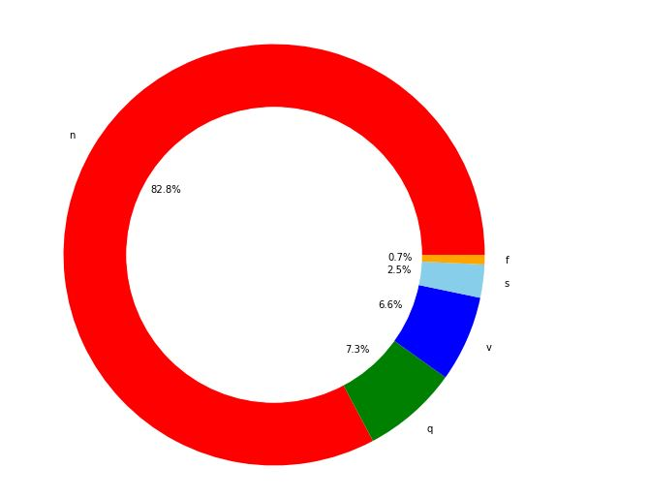
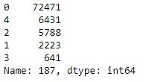
Data set Class Distribution
Initial Class distribution of the data set shows highly imbalanced data !
This will affect model performance for detecting anomalies

Slide 12
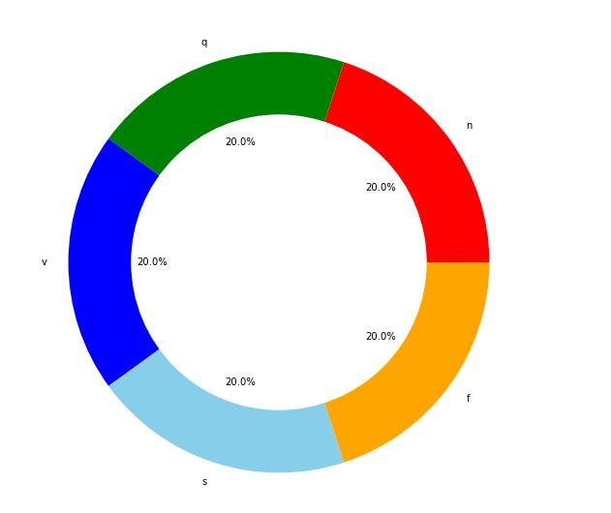
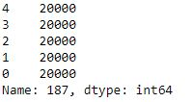
Data set resampling
Resampled the data set to have a balanced class distribution
Each class now has 20,000 samples each

Slide 13
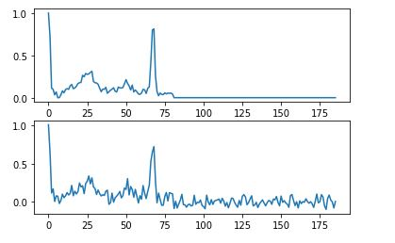
Other preprocessing techniques
Added some noise to the data to make it more generalized

Slide 14
Keras
Open-source neural-network library written in Python
Can run on top of Tensorflow, Theano and other machine learning frameworks
User Friendly, Modular and Extensible

Slide 15
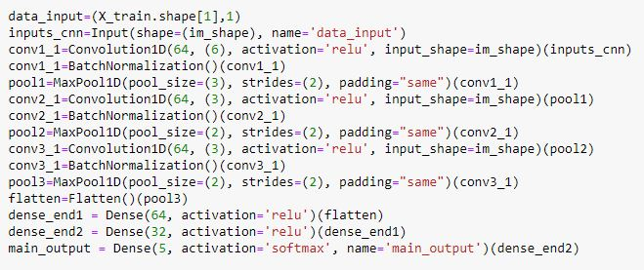
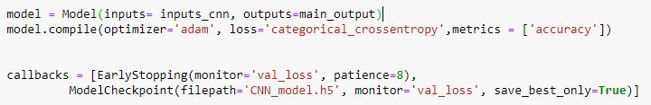
Model Architecture

Slide 16
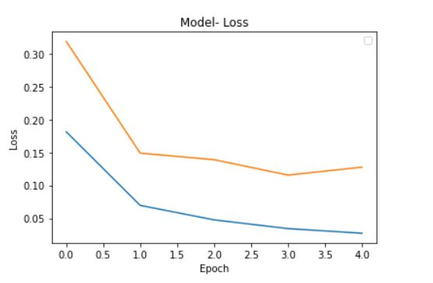
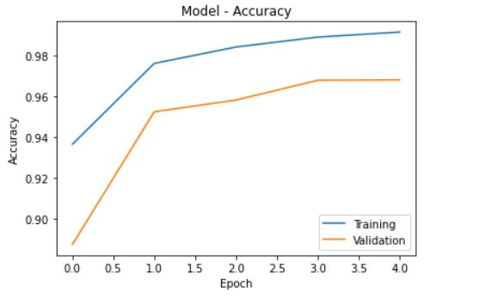
Results
The graphs below show the training accuracy and validation loss over 5 epochs

Slide 17
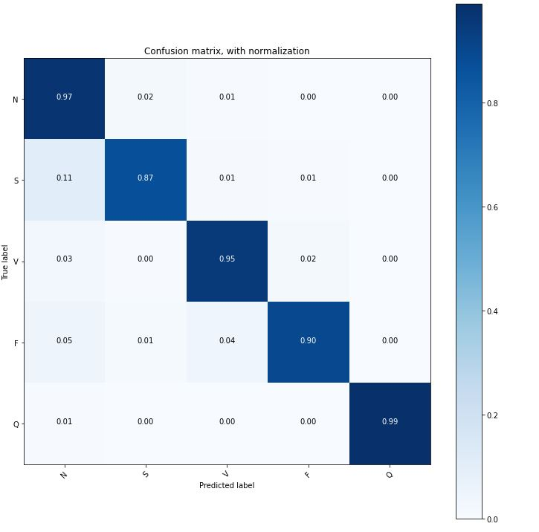
Results
The confusion matrix shows that the model performs on the test set with slight decrease in results for the two classes S and F

Slide 18
STM32.AI
Interoperable with popular deep learning training tools (Keras)
Compatible with many IDEs and compilers (Keil)
Sensor and RTOS agnostic
Allows multiple Artificial Neural Networks to be run on a single STM32 MCU
Full support for ultra-low-power STM32 MCUs

Slide 19
What’s next?
Check if the resulting readings are correct and if they need noise filtering.
Adjust sampling rate according to the user’s input.
Use STM32.AI to deploy model on MCU
Apply needed preprocessing tasks to captured data and use model for inference

